Slide 1
The Rhode Island
State Crime Lab:
Forensic Examinations@URI
Dennis C. Hilliard, M.S.
Director – RI State Crime Laboratory
Co-Director – URI Forensic Science Partnership
Adj. Professor – College of Pharmacy, URI
https://web.uri.edu/riscl/

Slide 2






Slide 3
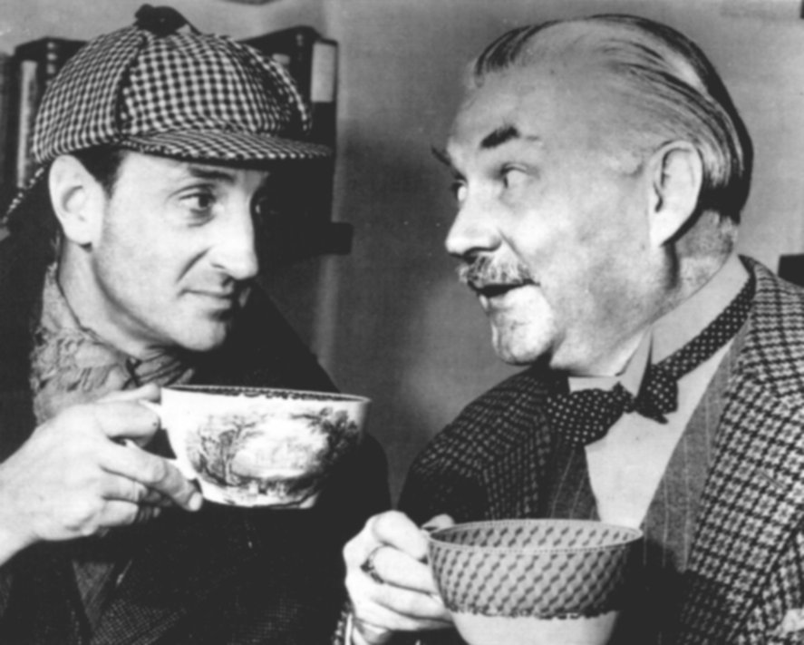
Not So Elementary, My Dear Watson

Slide 4


Slide 5


Slide 6
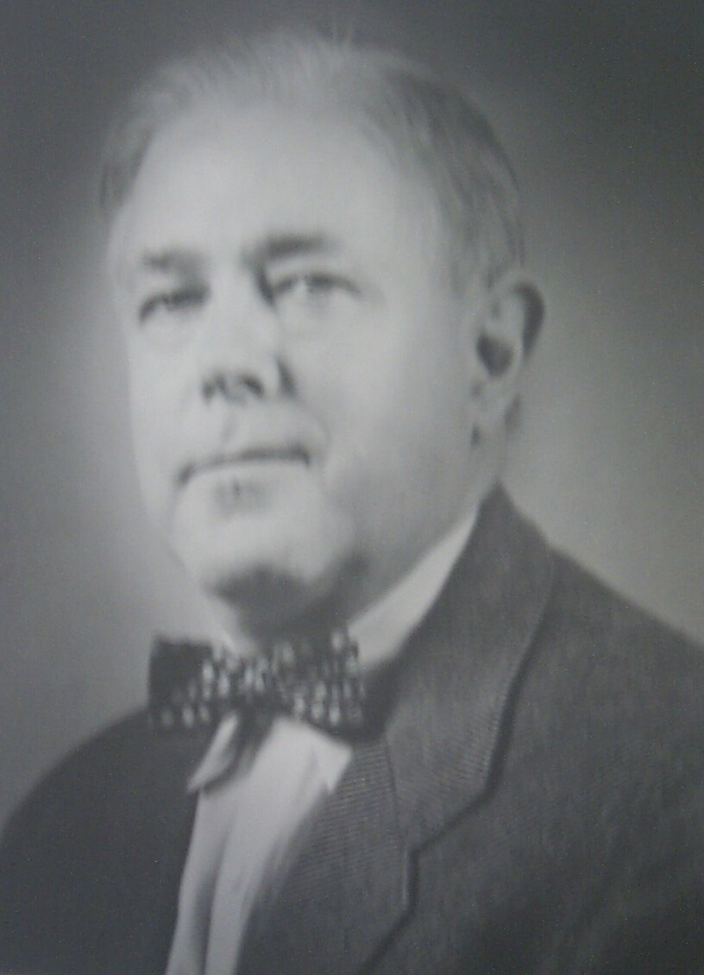
Dr. Harold Harrison
Professor of Chemistry
1951 - 1970

Slide 7
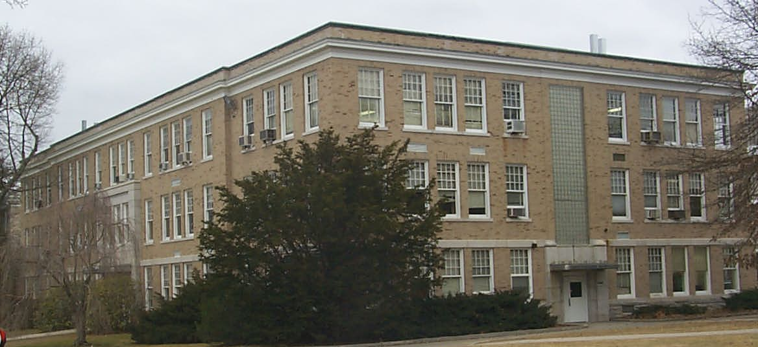
PASTORE HALL

Slide 8
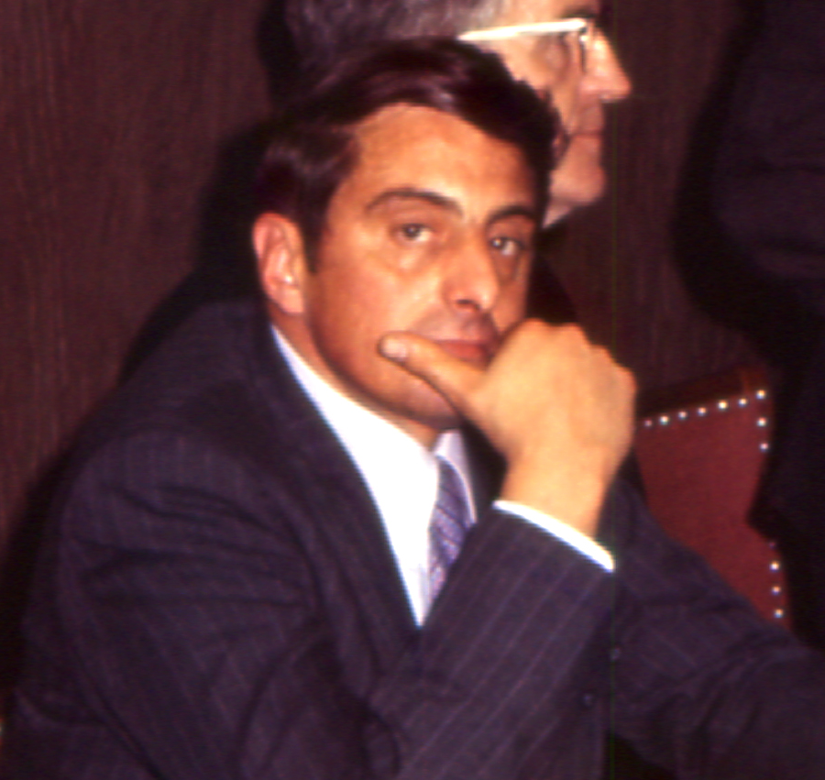
Dr. David DeFanti
Professor of Pharmacology & Toxicology
State Crime Laboratory Director
1970 - 1991

Slide 9
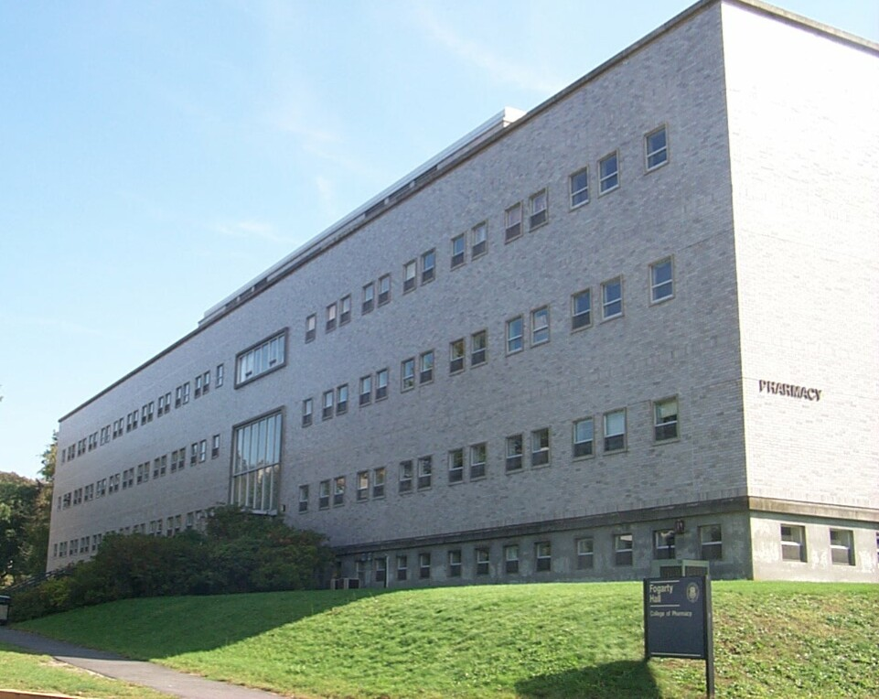

Slide 10
HISTORY
*Laboratories for Scientific Criminal Investigations: Dr. Harrison 1953*-1969
URI, part of Dr. Harrison’s work.
*Laboratories for Scientific Criminal Investigations: Dr. DeFanti 1970-1978
URI, part of Dr. DeFanti’s work + LEAA Grant funds
*State Crime Laboratory Commission and State Crime Laboratory Legislation 1978

Slide 11
HISTORY
1978: LEAA Program discontinued:
RI Legislation created the State Crime Laboratory Commission (1st in the US) and the State Crime Laboratory at URI.
Start-up funds provided and a per case cost was established to charge agencies that used the Laboratory services: $150 per case and $100 per court testimony. Start-up funds to be repaid after five years. Cities and towns did not pay for service.

Slide 12
Title 12
Criminal Procedure
State Crime Laboratory Commission
§ 12-1.1-1. Short title.
§ 12-1.1-2. Legislative findings and purpose.
§ 12-1.1-3. Creation.
§ 12-1.1-4. Membership.
§ 12-1.1-5. Chairperson.
§ 12-1.1-6. Executive secretary.
§ 12-1.1-7. Meetings.
§ 12-1.1-8. Powers and duties of commission.
§ 12-1.1-9. Repealed.
§ 12-1.1-10. Cooperation of departments — Using facilities of the University of Rhode Island.

Slide 13
TITLE 12
Criminal Procedure
State Crime Laboratory
§ 12-1.2-1. Creation.
§ 12-1.2-2. Jurisdiction.
§ 12-1.2-3. Functions of the state crime laboratory.
§ 12-1.2-4. Funding.
§ 12-1.2-5. Director of state crime laboratory — Term.
§ 12-1.2-6. Candidates for director and other positions — Selection — Appointment — Dismissals.
§ 12-1.2-7. Powers and duties of director.

Slide 14
State Crime Laboratory
§ 12-1.2-1. Creation.
There shall be a state crime laboratory located at the University of Rhode Island.
§ 12-1.2-2. Jurisdiction.
The state crime laboratory shall have the authority to investigate any and all evidence relating to state or local crimes when requested by appropriate agencies.
§ 12-1.2-4. Funding.
The state crime laboratory shall be funded through the budget of the University of Rhode Island.
History of Section.
P.L. 1985, ch. 120, art. 4, § 2; P.L. 2009, ch. 68, art. 5, § 4; P.L. 2011, ch. 151, art. 9, § 1.

Slide 15
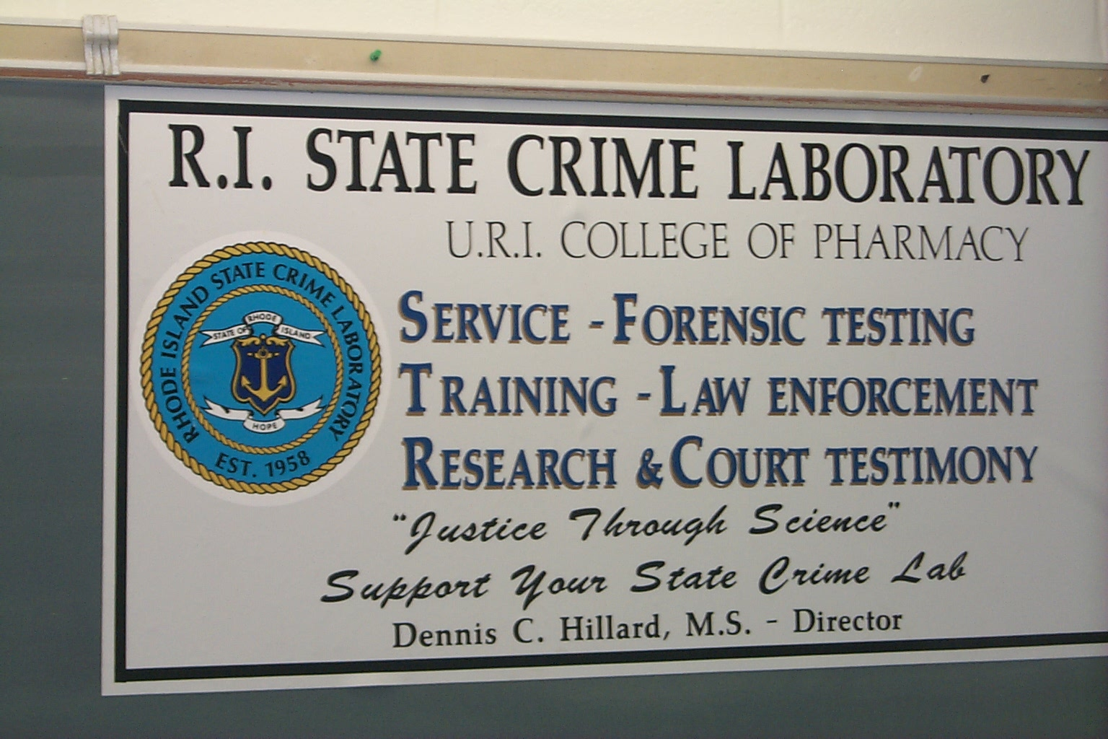

Slide 16
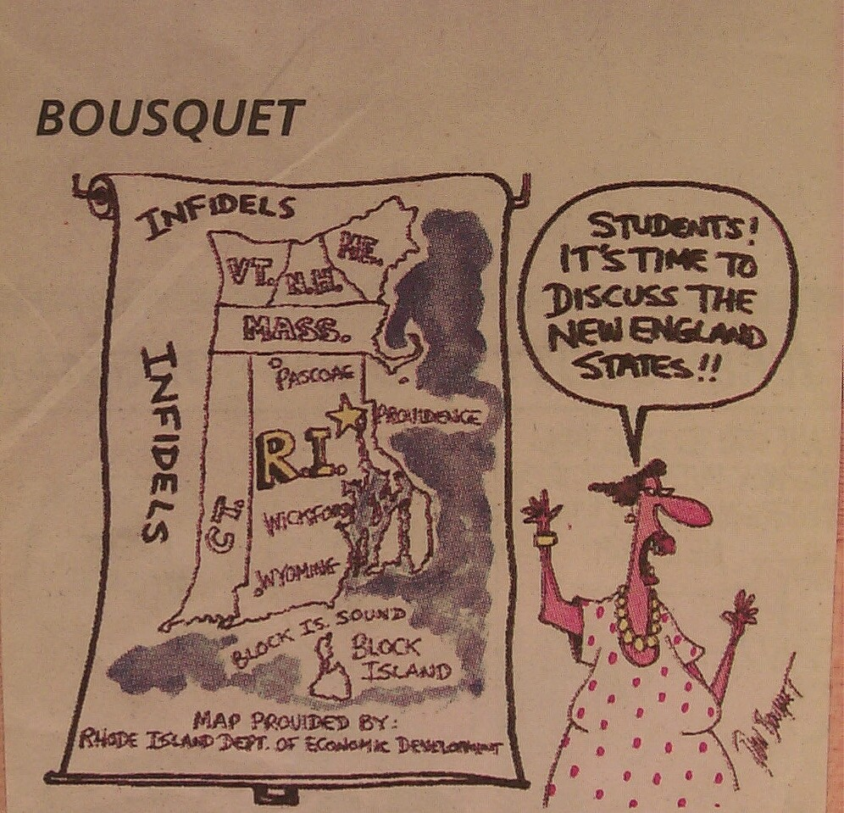

Slide 17
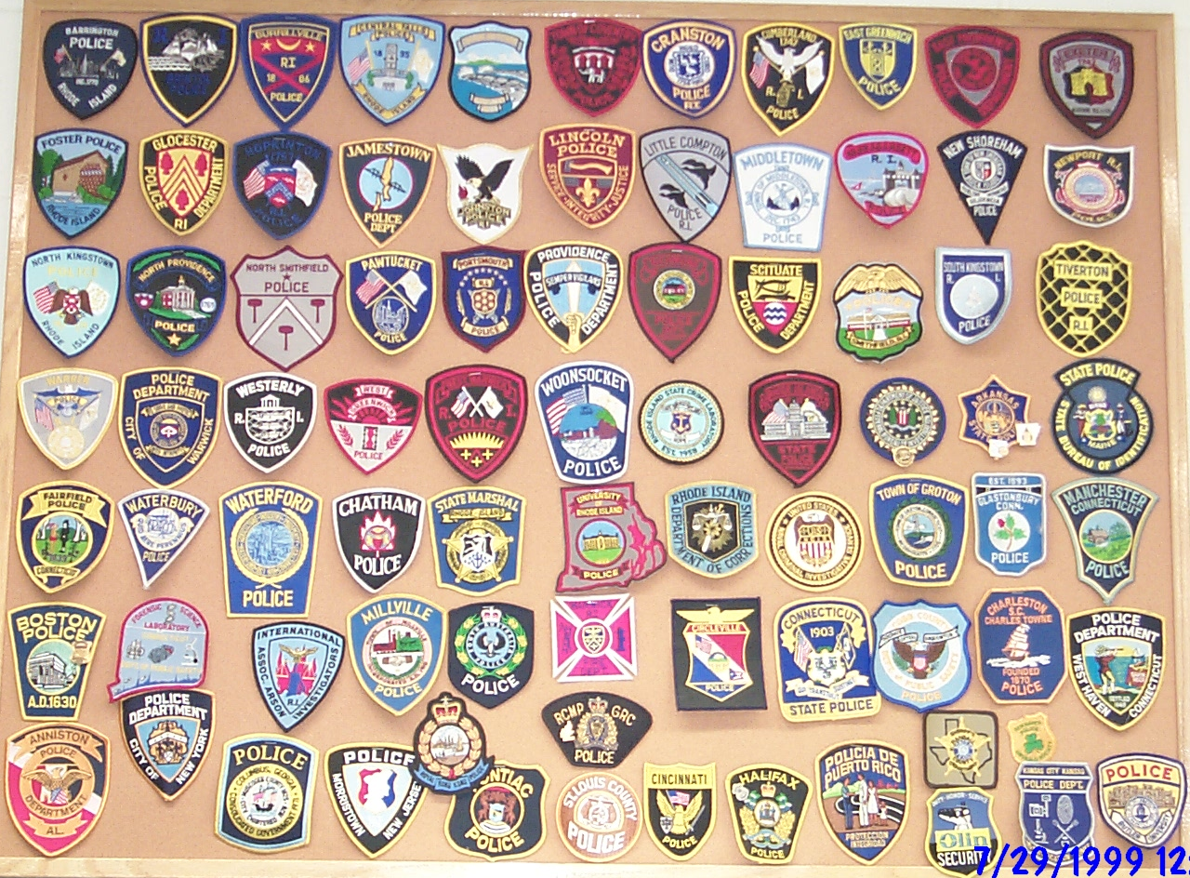
b

Slide 18
Funding History
1985 – Legislation changed to provide a line-item funding source from the State Budget to the State Crime Laboratory through the Office of the Attorney General
2009 – Legislation changed to move the line-item funding source from the State Budget to the State Crime Laboratory through the Department of Health
2011 - Legislation changed to move the line-item funding source from the State Budget to the State Crime Laboratory through the University of Rhode Island

Slide 19
Federal Grants
LEAA: Law Enforcement Assistance Act
Direct Grant: Senator Reed
NFSIA/Coverdell Forensic Science Improvement Act
Byrne/JAG – Justice Assistance Grants
CESF – Coronavirus Emergency Supplemental Funds

Slide 20
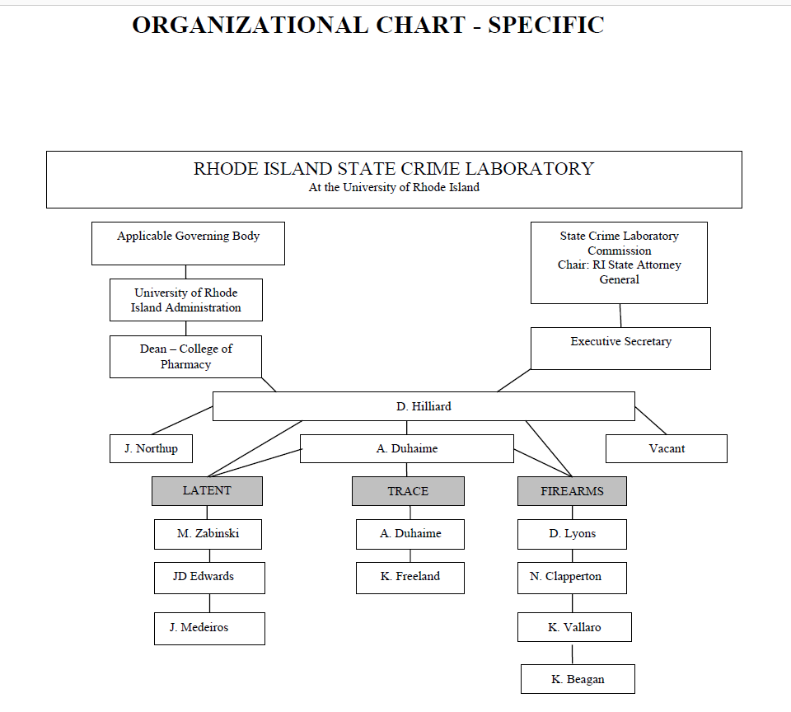

Slide 21
RI STATE CRIME LABORATORY
ADMINISTRATION
  DENNIS H. & JANE
LATENT PRINT SECTION
  MARK, JD & JIM
TRACE SECTION
  AMY & KIM
FIREARMS SECTION
  NEIL, DENNIS L., KAREN, & KIT

Slide 22
RISCL Case Load
2017 2018 2019 2020 2021
Cases: 722 711 670 779 913
Exhibits: 3080 3890 3432 4632 4900
Court: 3 3 3 3 2

Slide 23
Progress Reports
State Crime Laboratory Commission
  Meets on a quarterly basis (open meeting)
Director provides a progress report:
  Number of cases submitted per agency
  Crime category type: # of cases, # of items
  Case backlogs, staffing and equipment needs
  Activities of Laboratory staff to include training, meetings, tour, lectures, service on local, regional, and national committees.

Slide 24
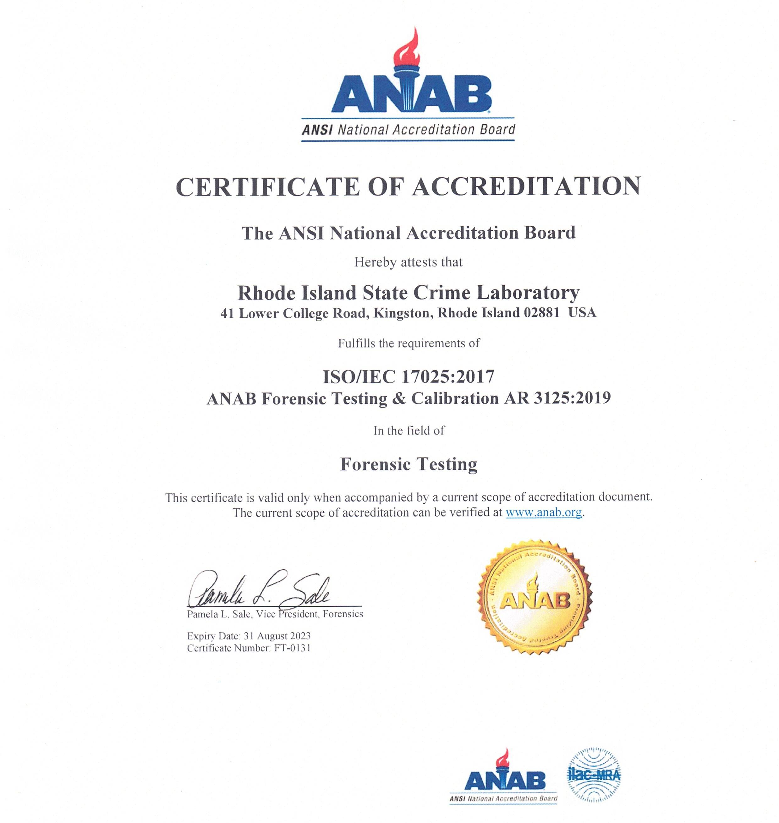

Slide 25
Wherever he steps, whatever he touches, whatever he leaves, even unconsciously, will serve as a silent witness against him. Not only his fingerprints or his footprints, but his hair, the fibers from his clothes, the glass he breaks, the tool mark he leaves, the paint he scratches, the blood or semen he deposits or collects. All of these and more, bear mute witness against him. This is evidence that does not forget. It is not confused by the excitement of the moment. It is not absent because human witnesses are. It is factual evidence. Physical evidence cannot be wrong, it cannot perjure itself, it cannot be wholly absent. Only human failure to find it, study and understand it, can diminish its value.
  - Professor Edmond Locard

Slide 26
Physical evidence examination can :
Link a suspect with the victim
Link a person to a crime scene
Link an object to a crime
Disprove or support witness testimony
Identify a person
Aid in the Reconstruction of a crime

Slide 27
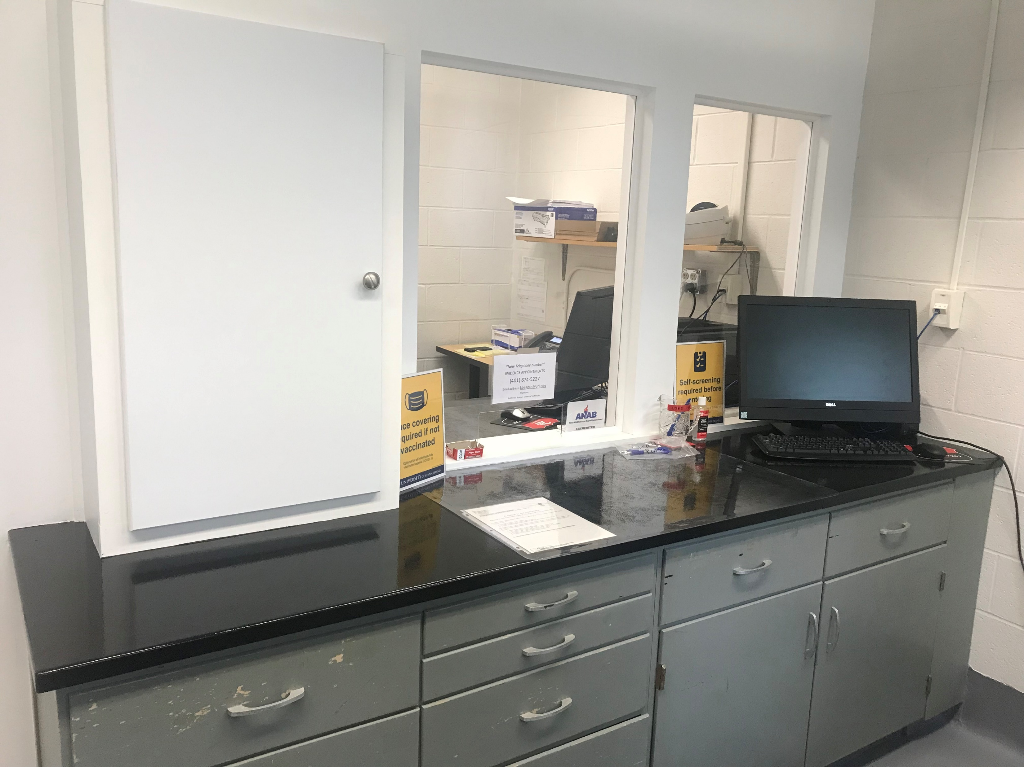

Slide 28
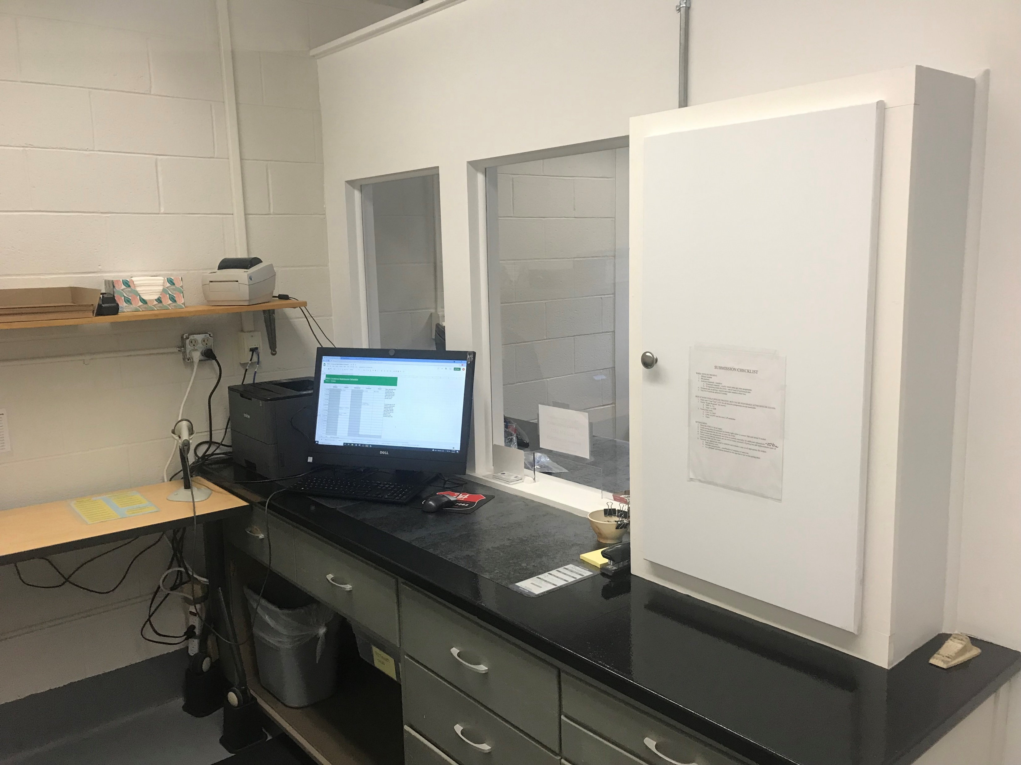

Slide 29
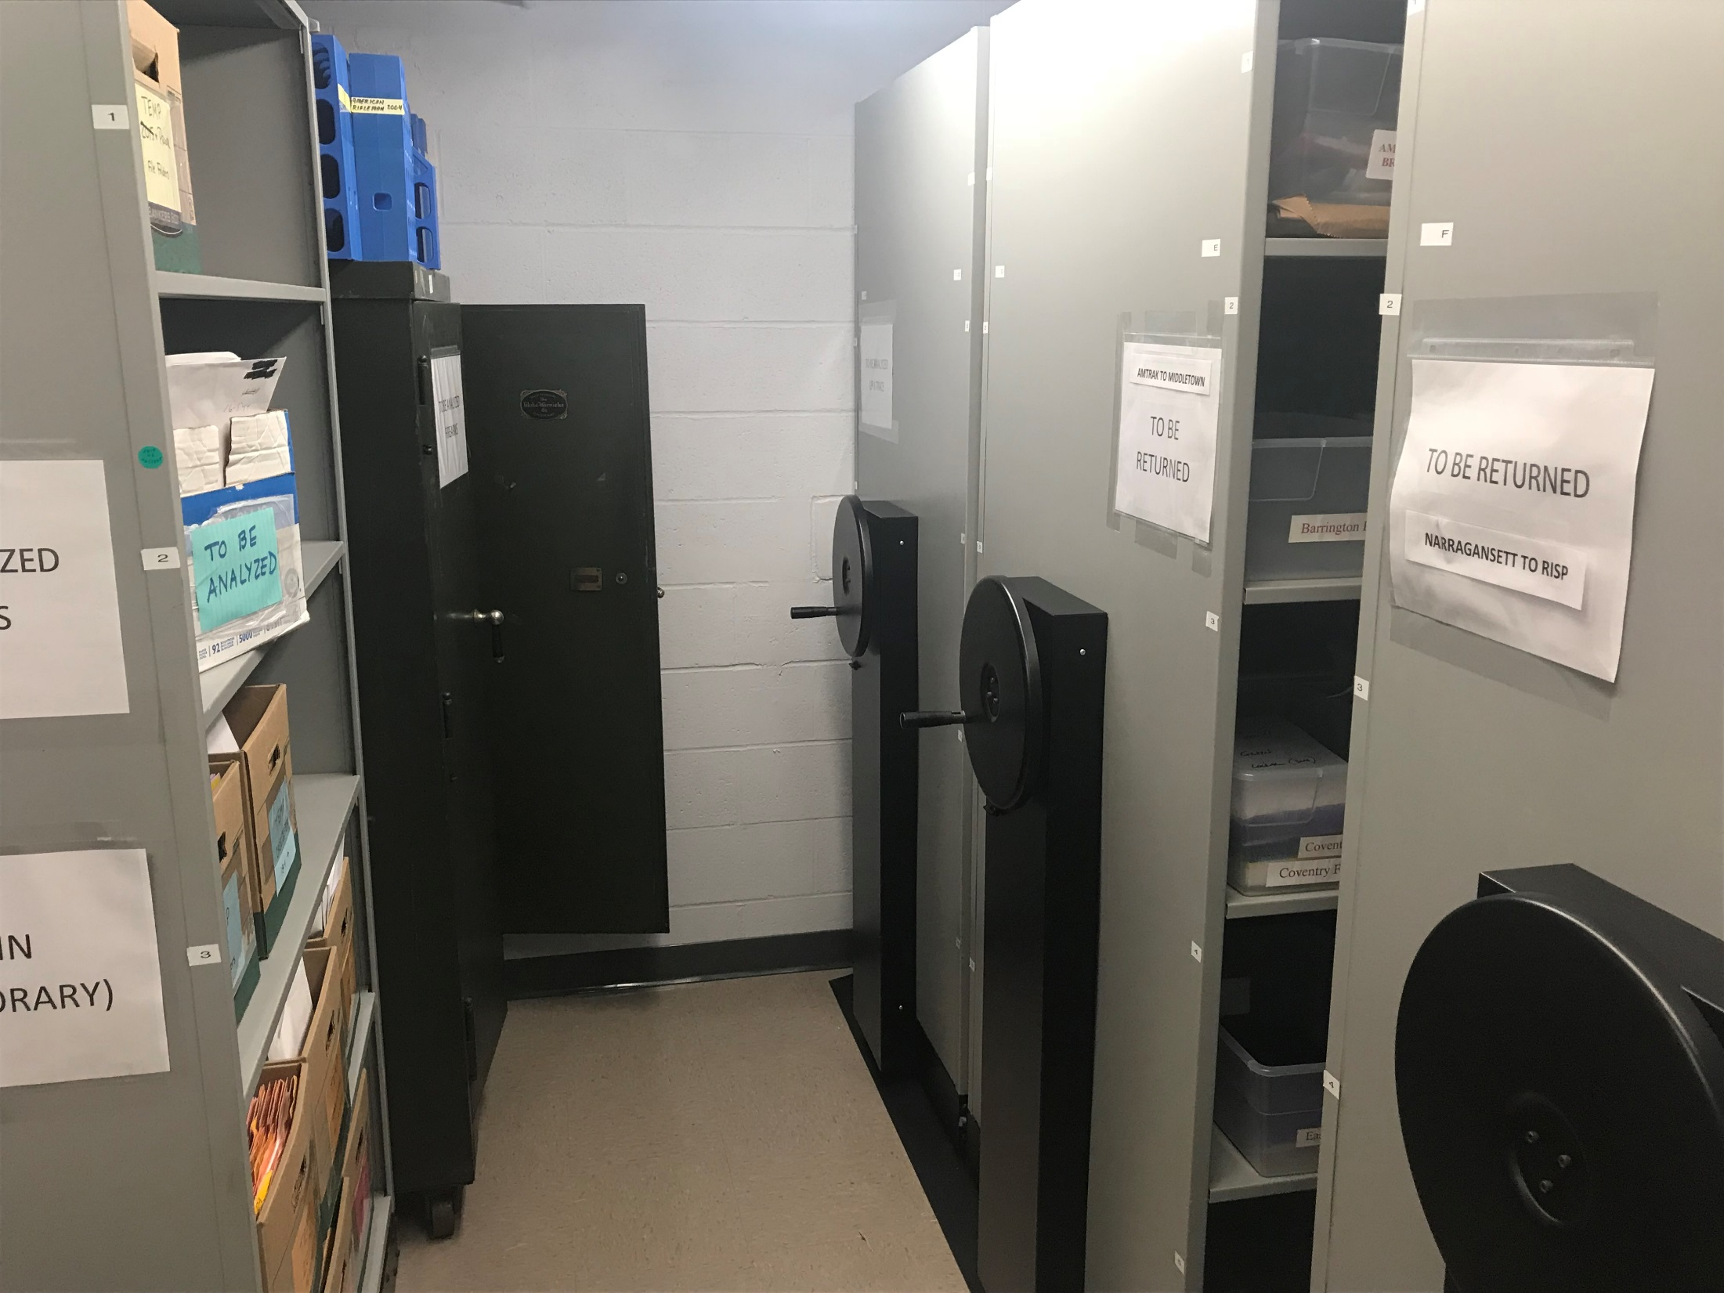

Slide 30
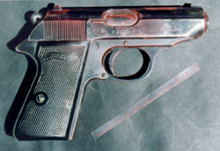
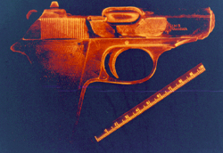
LATENT PRINTS
ALTERNATE LIGHTING SOURCE

Slide 31
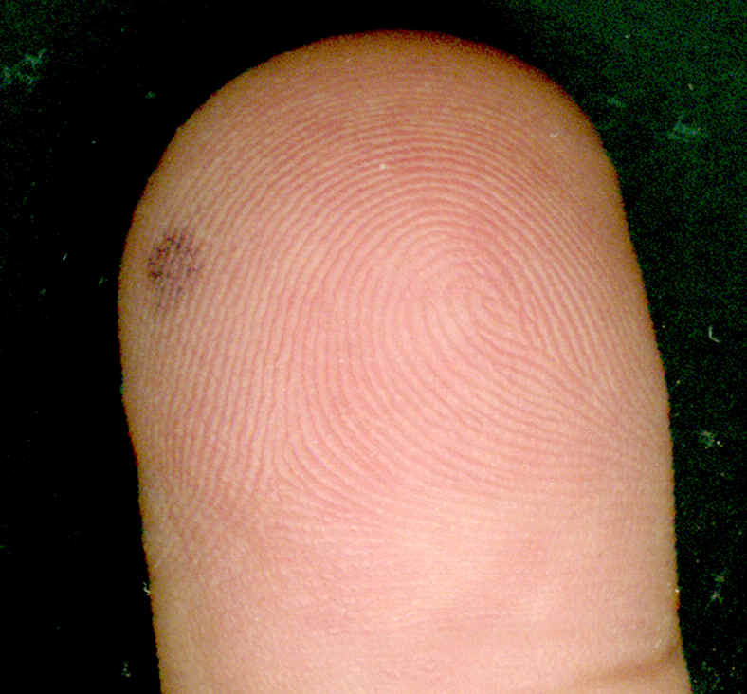

Slide 32
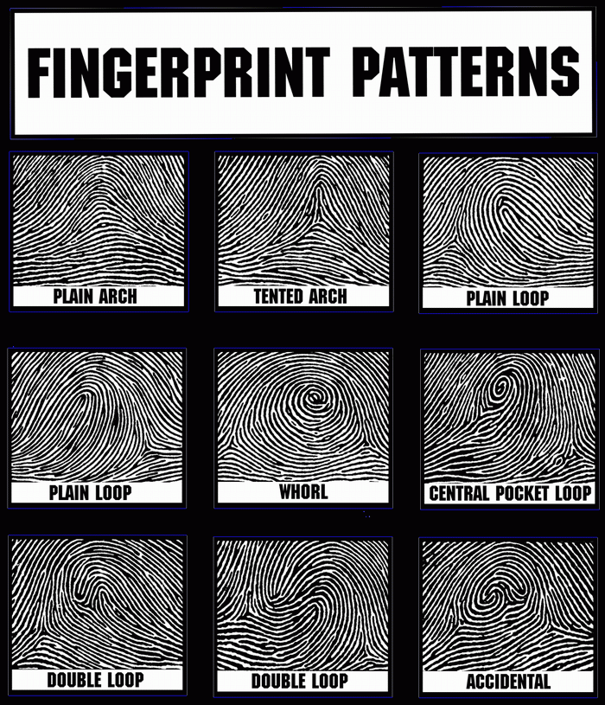

Slide 33
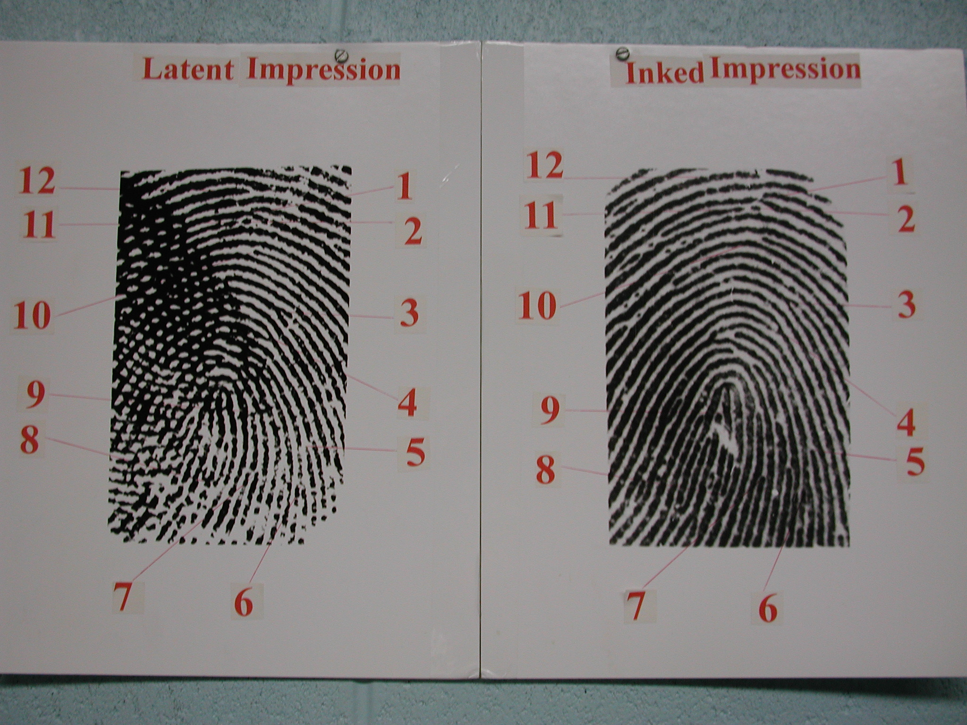

Slide 34
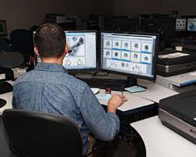
AFIS WORKSTATION

Slide 35
Types of Trace Evidence
Hairs
Fibers
Glass
Paint
Soil
Gun shot residue
Plastics
Impressions
Vegetation
Fire debris
Animal material
Metal shavings

Slide 36
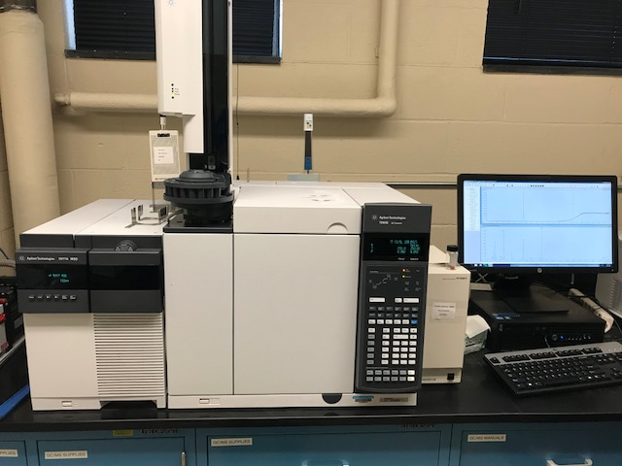

Slide 37
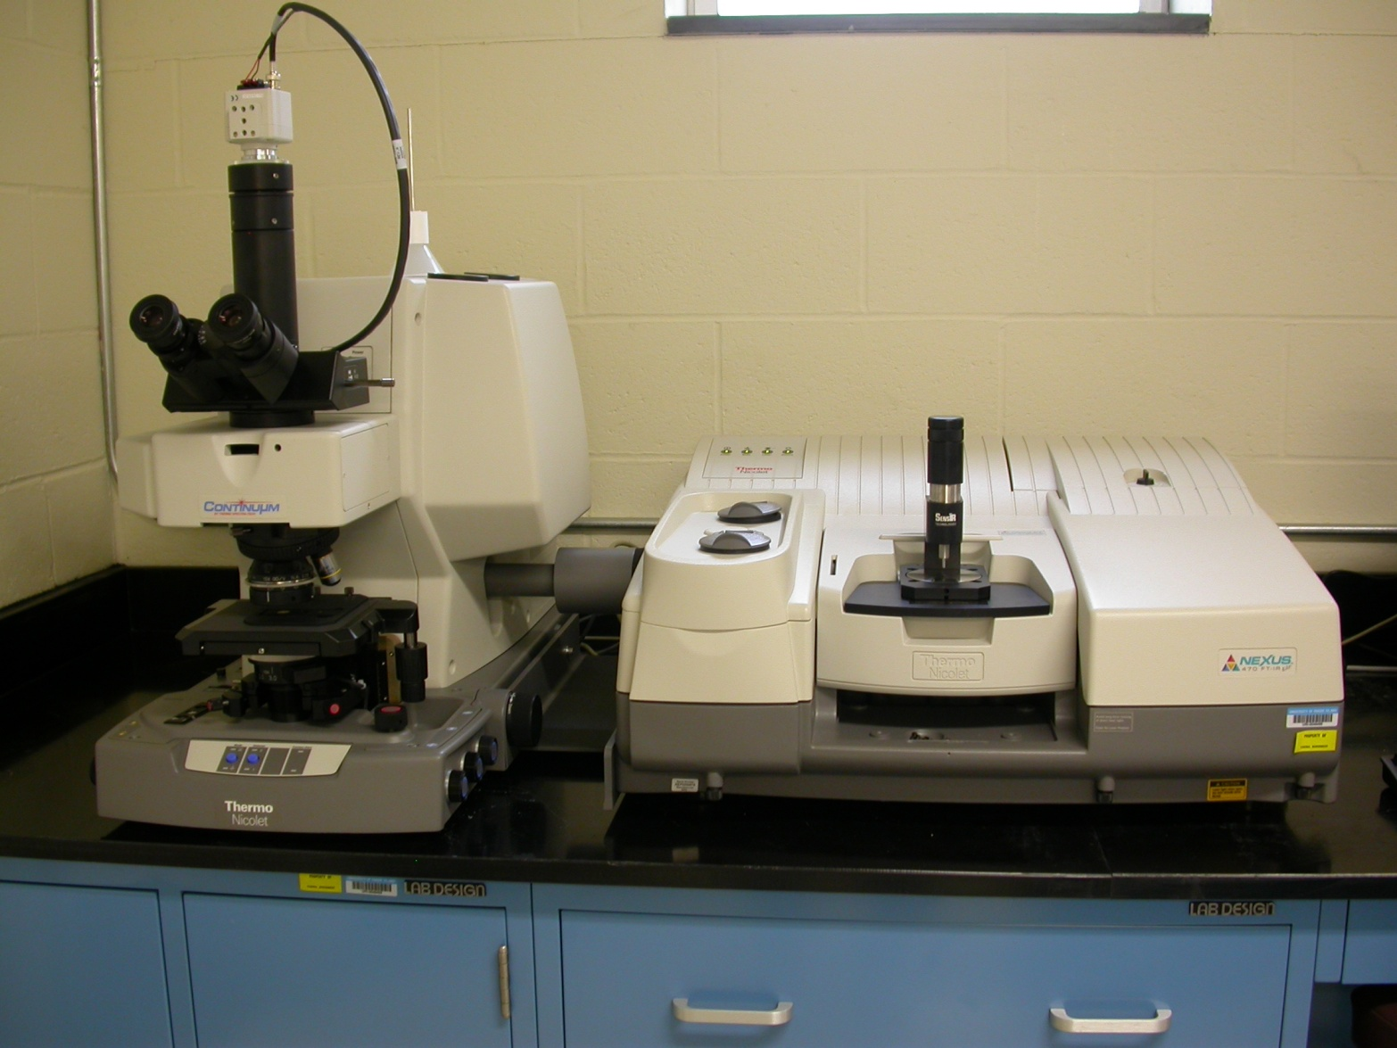
FT-IR ANALYSIS
Fourier Transform Infrared Spectroscopy – FT-IR

Slide 38
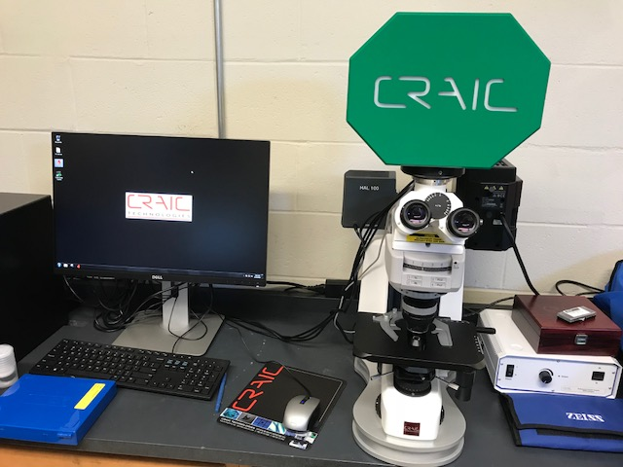

Slide 39
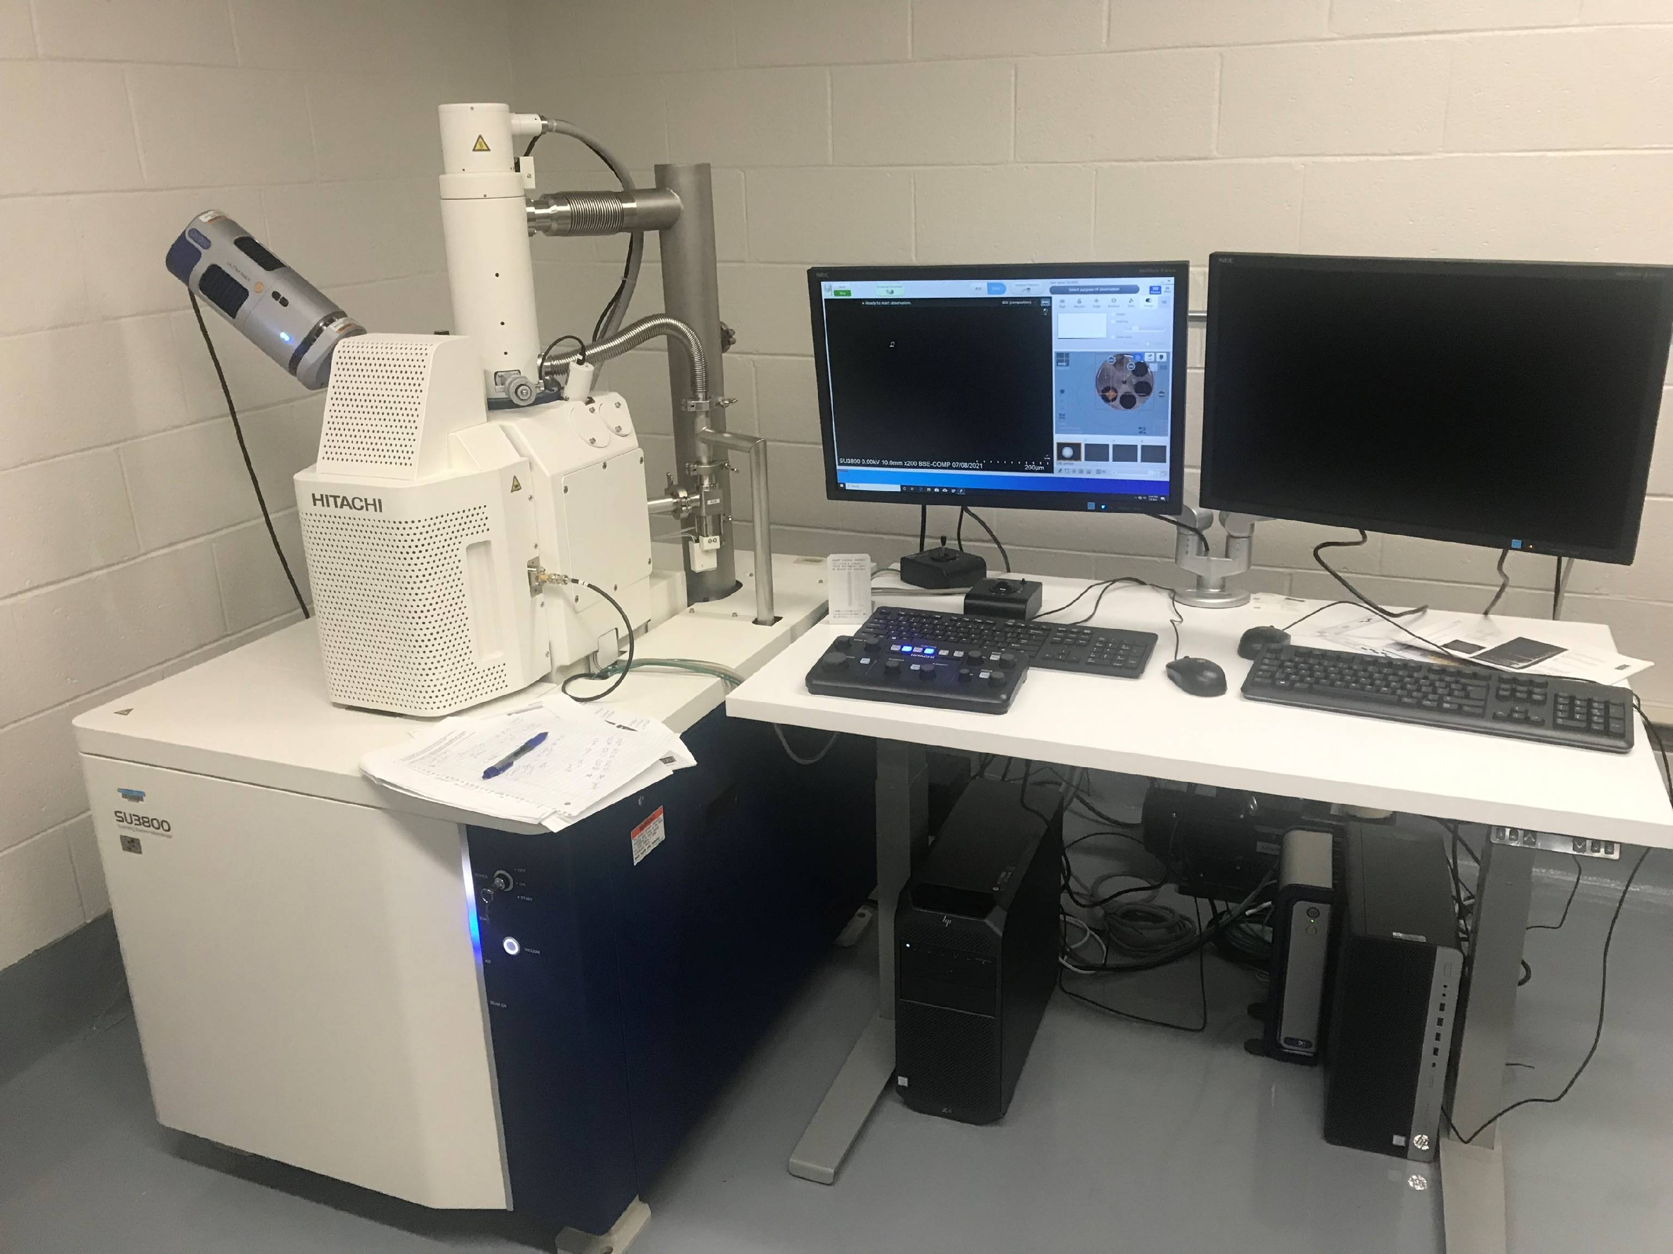
SCANNING ELECTRON MICROSCOPE

Slide 40


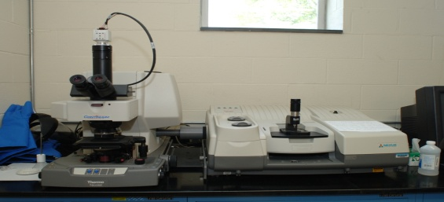
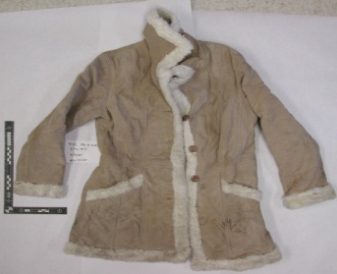
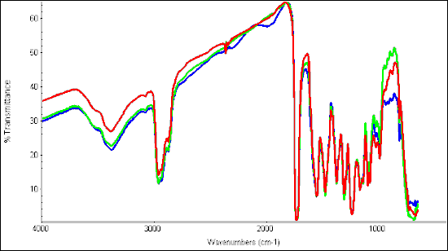
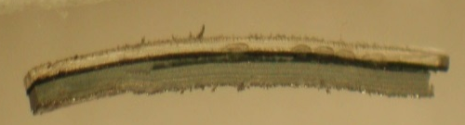
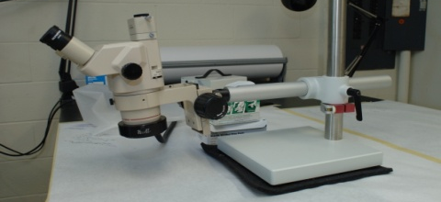
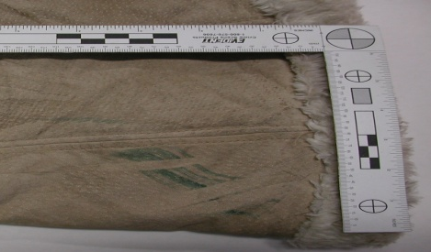
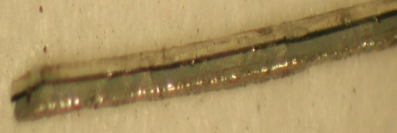
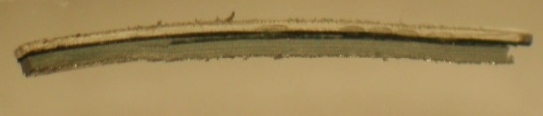
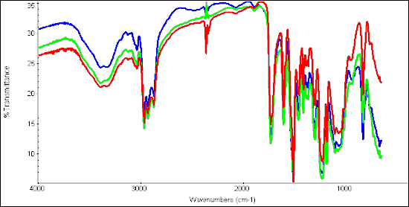
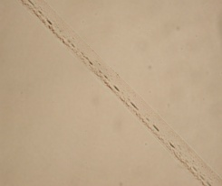
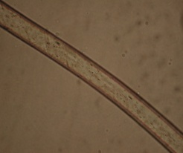
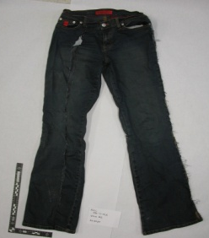

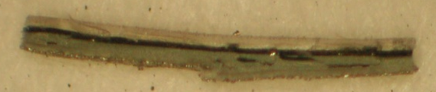
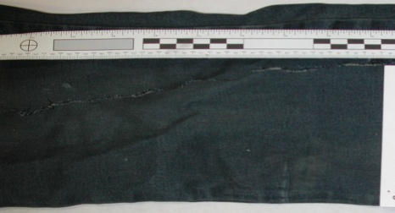
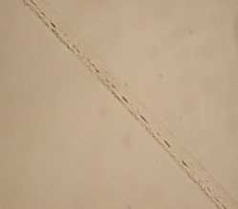
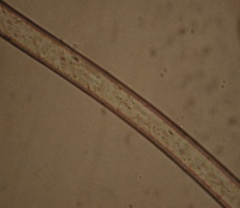
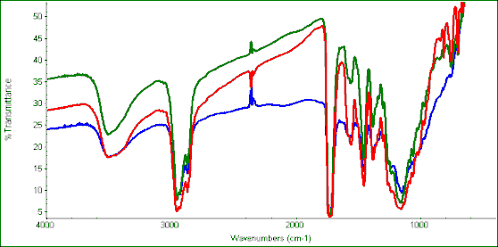
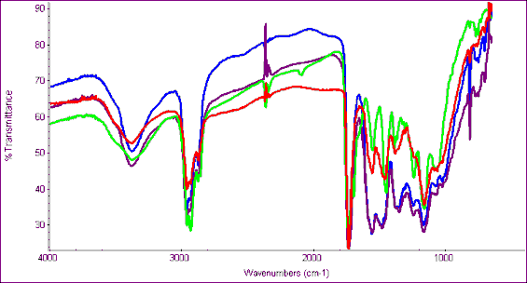
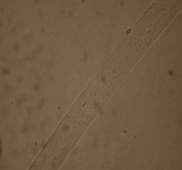
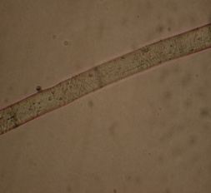
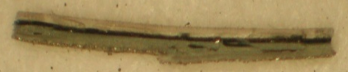
RISCL HIT AND RUN
FACTS FROM CASE
EVIDENCE
PAINT EVIDENCE
PAINT EVIDENCE-GRAY PRIMER
Pedestrian was hit by an unknown vehicle.
Suspect of the unknown vehicle left the scene of the accident.
Vehicle believed to be responsible for hit and run was
recovered hours after accident.
  Paint from scene of accident
  Paint from suspect’s vehicle
  Fibers from suspect’s vehicle
  Victim’s jacket
  Victim’s jeans
Paint evidence compared using the Microscope FT-IR.
Red- Paint chip from crime scene
Green- Paint chip from suspect’s vehicle
Blue- Paint chip from victim’s clothing
EVIDENCE FROM VICTIM
EVIDENCE FROM CRIME SCENE
Victim’s jacket
Paint chip found at crime scene
Four layers noted: clear coat, green metallic color, blue-gray primer, & silver metallic bottom
EVIDENCE FROM SUSPECT’S VEHICLE
Paint chips examined using the stereo-microscope
Green rub located on right pocket of victim’s jacket
PAINT EVIDENCE-SILVER LAYER
Red- Paint chip from crime scene
Green –Paint chip from suspect’s vehicle
Blue- Paint chip from victim’s clothing
PAINT EVIDENCE
Clear Coat
Gray Primer
Paint sample, four layers noted: Clear coat, green metallic color, blue-grey primer, silver metallic bottom
Dark Green Color Coat
Paint chip from the crime scene
Silver Metallic Primer
Victim’s jeans
Unknown Acrylic Fiber
Unknown Polyester Fiber
Green rub located on victim’s right pant leg
    Colorless fibers pulled from damaged area of vehicle
Paint chip from the suspect’s vehicle
FIBER EVIDENCE
Paint chip from victim’s clothing
Green- Paint from suspect’s vehicle
Red-Paint from crime scene
Blue- Paint from victim’s clothing
CLEAR COAT LAYER
PAINT EVIDENCE-GREEN METALLIC
Blue- Paint from crime scene
Purple- Paint from suspect’s vehicle
Green- Paint smear from victim’s jacket
Red- Paint from victim’s clothing
Unknown acrylic (suspect’s vehicle)
Unknown Polyester (suspect’s vehicle)
Known acrylic (victim’s jacket)
Paint chip found on victim’s clothing
Four layers noted: clear coat, green metallic color, blue-gray primer, & silver metallic bottom
Based on physical and chemical properties:
  the paint chip found at the scene and the paint chip found in the victim’s clothing, could have originated from the suspect’s car
  the fibers found on the suspect’s car could have originated from the victim’s suede jacket
Known polyester (victim’s jacket)
RESULTS

Slide 41
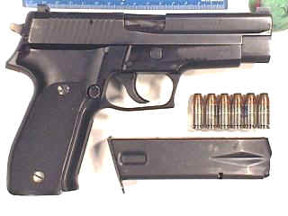
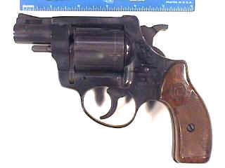
FIREARMS

Slide 42
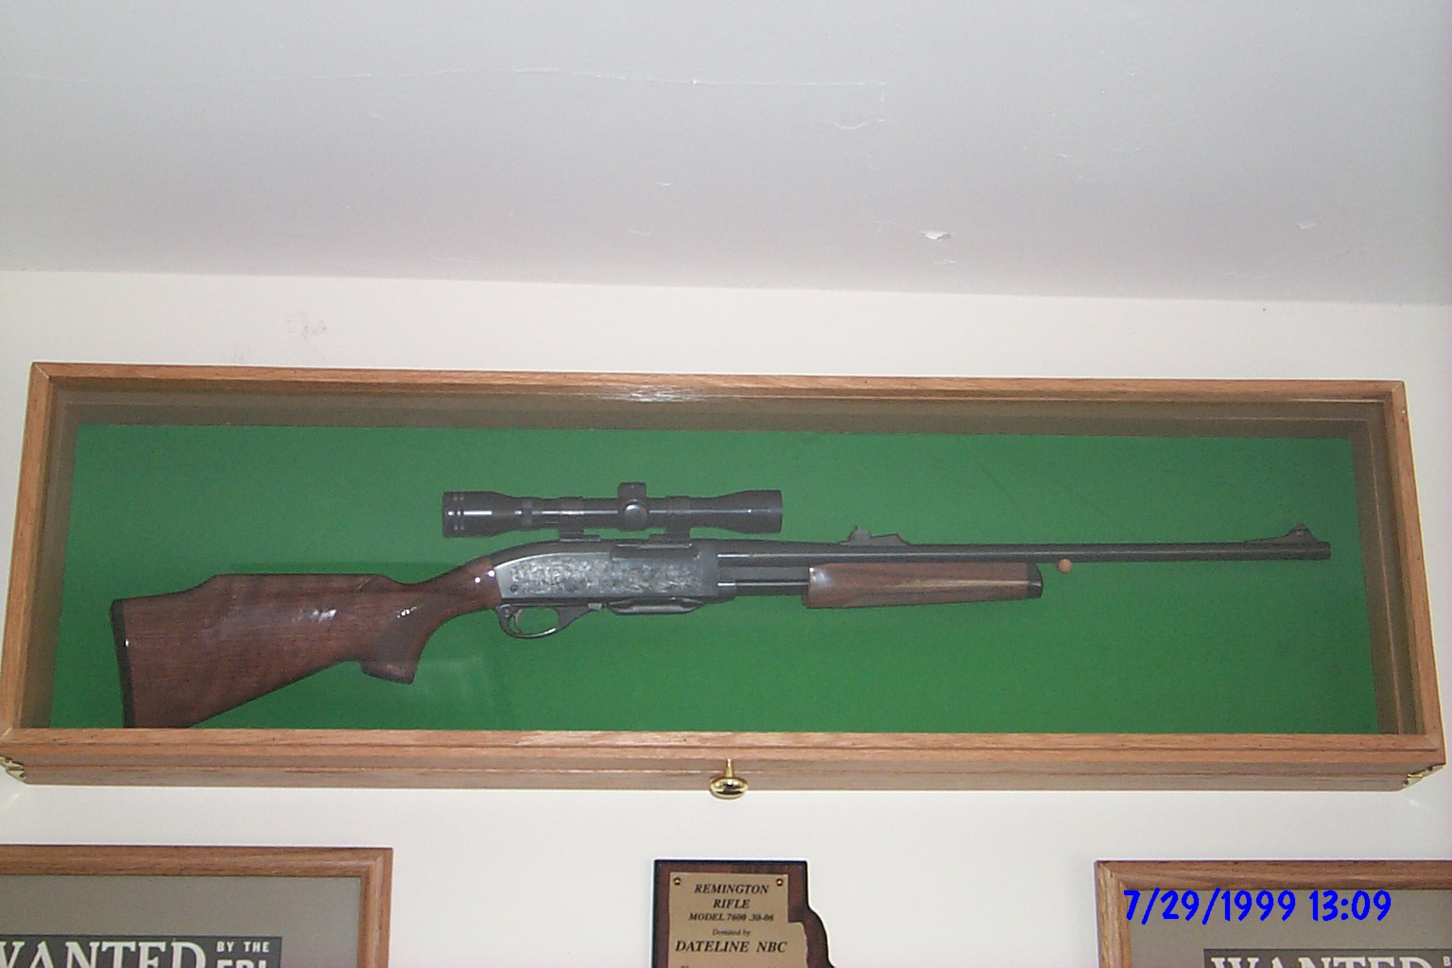

Slide 43
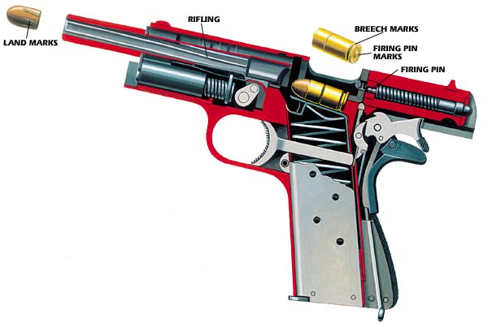

Slide 44
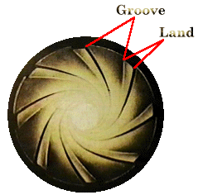

Slide 45
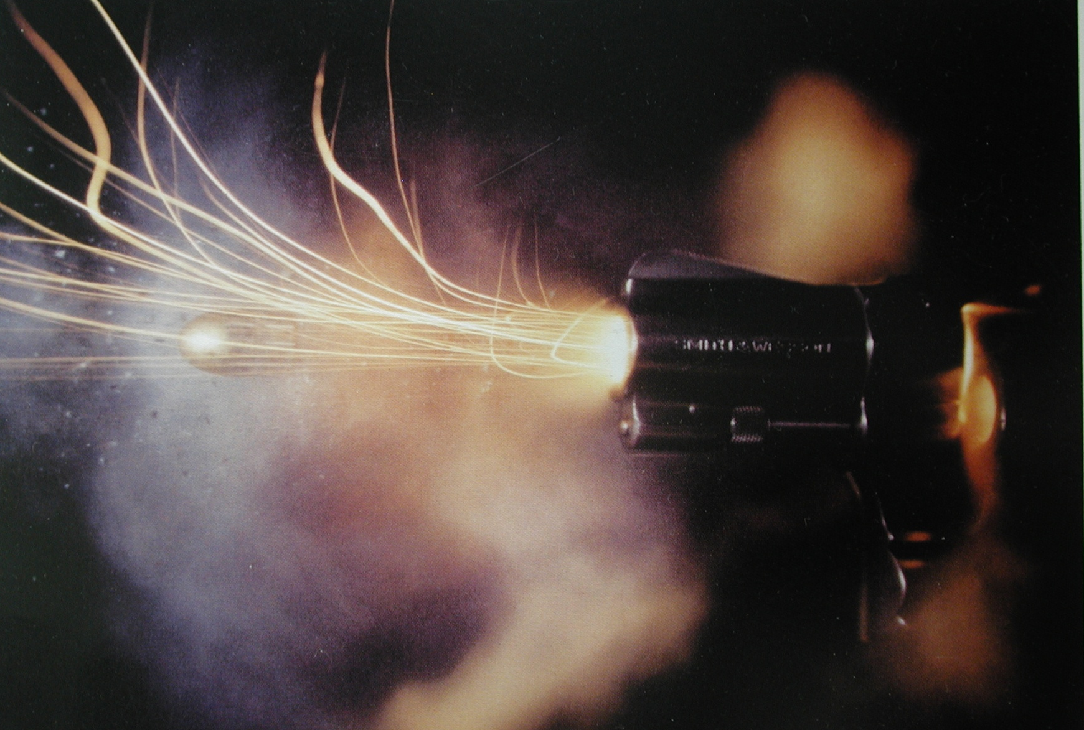
FIRING A HANDGUN

Slide 46

COMPARISON
MICROSCOPE
EXAMINATION

Slide 47

KNOWN
UNKNOWN
COMPARISON STRIATIONS

Slide 48

KNOWN
UNKNOWN
COMBINED IMAGE
UNDER COMPARISON MICROSCOPE

Slide 49

NIBIN WORK STATION

Slide 50


Slide 51
Forensic Science Partnership
April 1999
Seminars for credit & open to the public each semester since Fall 1999. https://www.chm.uri.edu/forensics/seminars.php
The Center of Excellence for Explosives Detection, Mitigation and Response: http://energetics.chm.uri.edu/
Digital Forensics and Cyber Security Center: https://web.uri.edu/cs/dfcsc/

Slide 52
“If the law has made you a witness, remain a man of science, you have no victim to avenge, no guilty or innocent person to convict or save – you must bear testimony within the limits of science.

Slide 53

The end result is successful testimony in a criminal prosecution.
Expert Testimony

Slide 54
RI Department of Health
Forensic Science Laboratory
Forensic Biology/DNA Analysis
Drug Chemistry Analysis
Toxicology/DUI/DUID Analysis
Breath Analysis Unit/DUI/DWI

Slide 55

“JUSTICE THROUGH SCIENCE”

Slide 56
THANK YOU!

